Slide 1
i-CAN Sorting System
Team 12

Slide 2
Overview
Meet the Team
Industry Partners
Project Summary
Mechanical
Electrical
Software
Questions

Slide 3
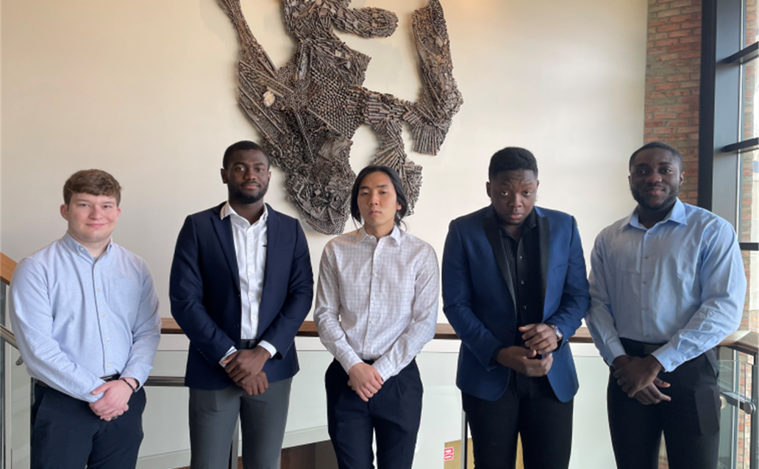

Meet the Team

Slide 4

Andrew David
Concentration:
Mechanical Engineer
Roles in The Project:
Designed bracketed pivot arm system.
Selected appropriate linear actuator
3D printed parts for the project
Folding sheet metal for the project

Slide 5

Kenneth Amoah Nyame
Concentration:
Electrical and Computer Engineering
Roles in the Project:
Wrote software for computer vision

Slide 6

Heon Soo Park
Concentration:
Electrical and Computer Engineering
Roles in The Project:
Designed the block diagram for the system--including power analysis for the system.
Helped wire up the whole system
Helped develop the software for GPIO pins in the Jetson Nano

Slide 7

Yaw Ammann Boakye
Concentration:
Electrical and Computer Engineering
Roles in the Project:
Function Block Diagram and Ladder logic programming for PLCs to run the conveyor.

Slide 8

Robert Akinie
Concentration:
Electrical and Computer Engineering
Roles in the Project:
CAD design of system.
Assisted with system wiring and set-up.
Assisted with writing various programs related to GPIO pins and sensor communication.
Assisted with object detection software configuration

Slide 9
Industry Partners

Slide 10



Industry Partners
Rob Spykerman, PADNOS Recycling [Industry Feed]
Ron David, Engineering Manager, DEMATIC [Conveyor Belt]

Slide 11
Project Summary

Slide 12
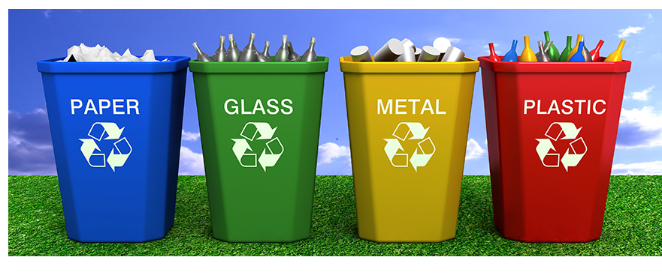
Problem Definition
People have a hard time sorting trash properly (between recyclable and non-recyclable)
It’s harder to sort trash after all the trash have been combined, making more recyclable materials to be thrown away

Slide 13


Design Norms
Stewardship
Care

Slide 14
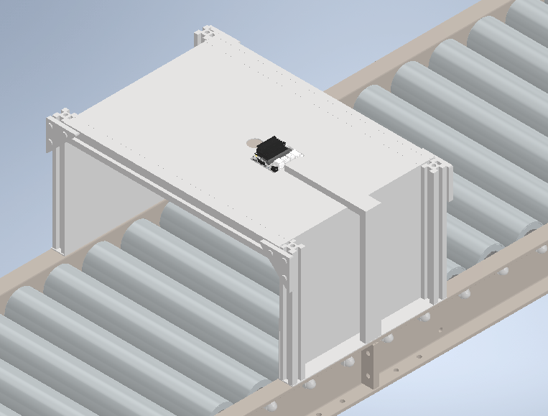
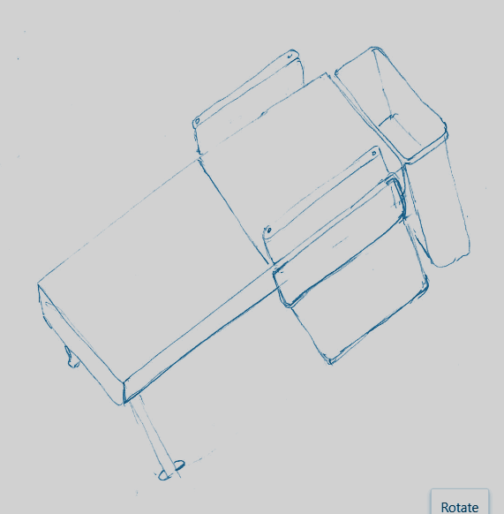
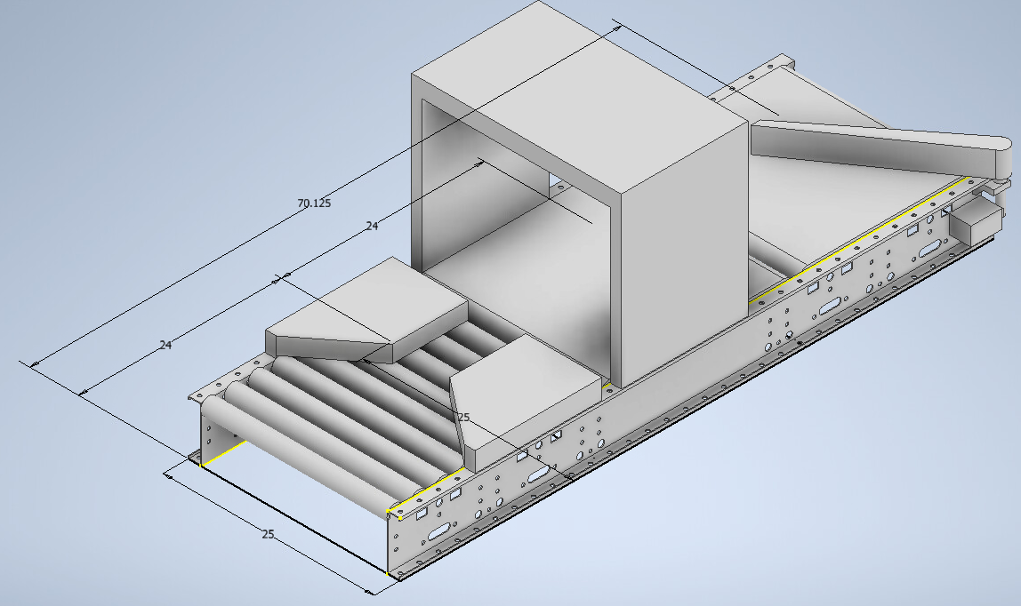
Solution
A sorting system that includes:
Camera that recognizes what type of trash item is put in
A conveyor belt system with two pivot arms on both sides which will help push the item into the correct bin

Slide 15
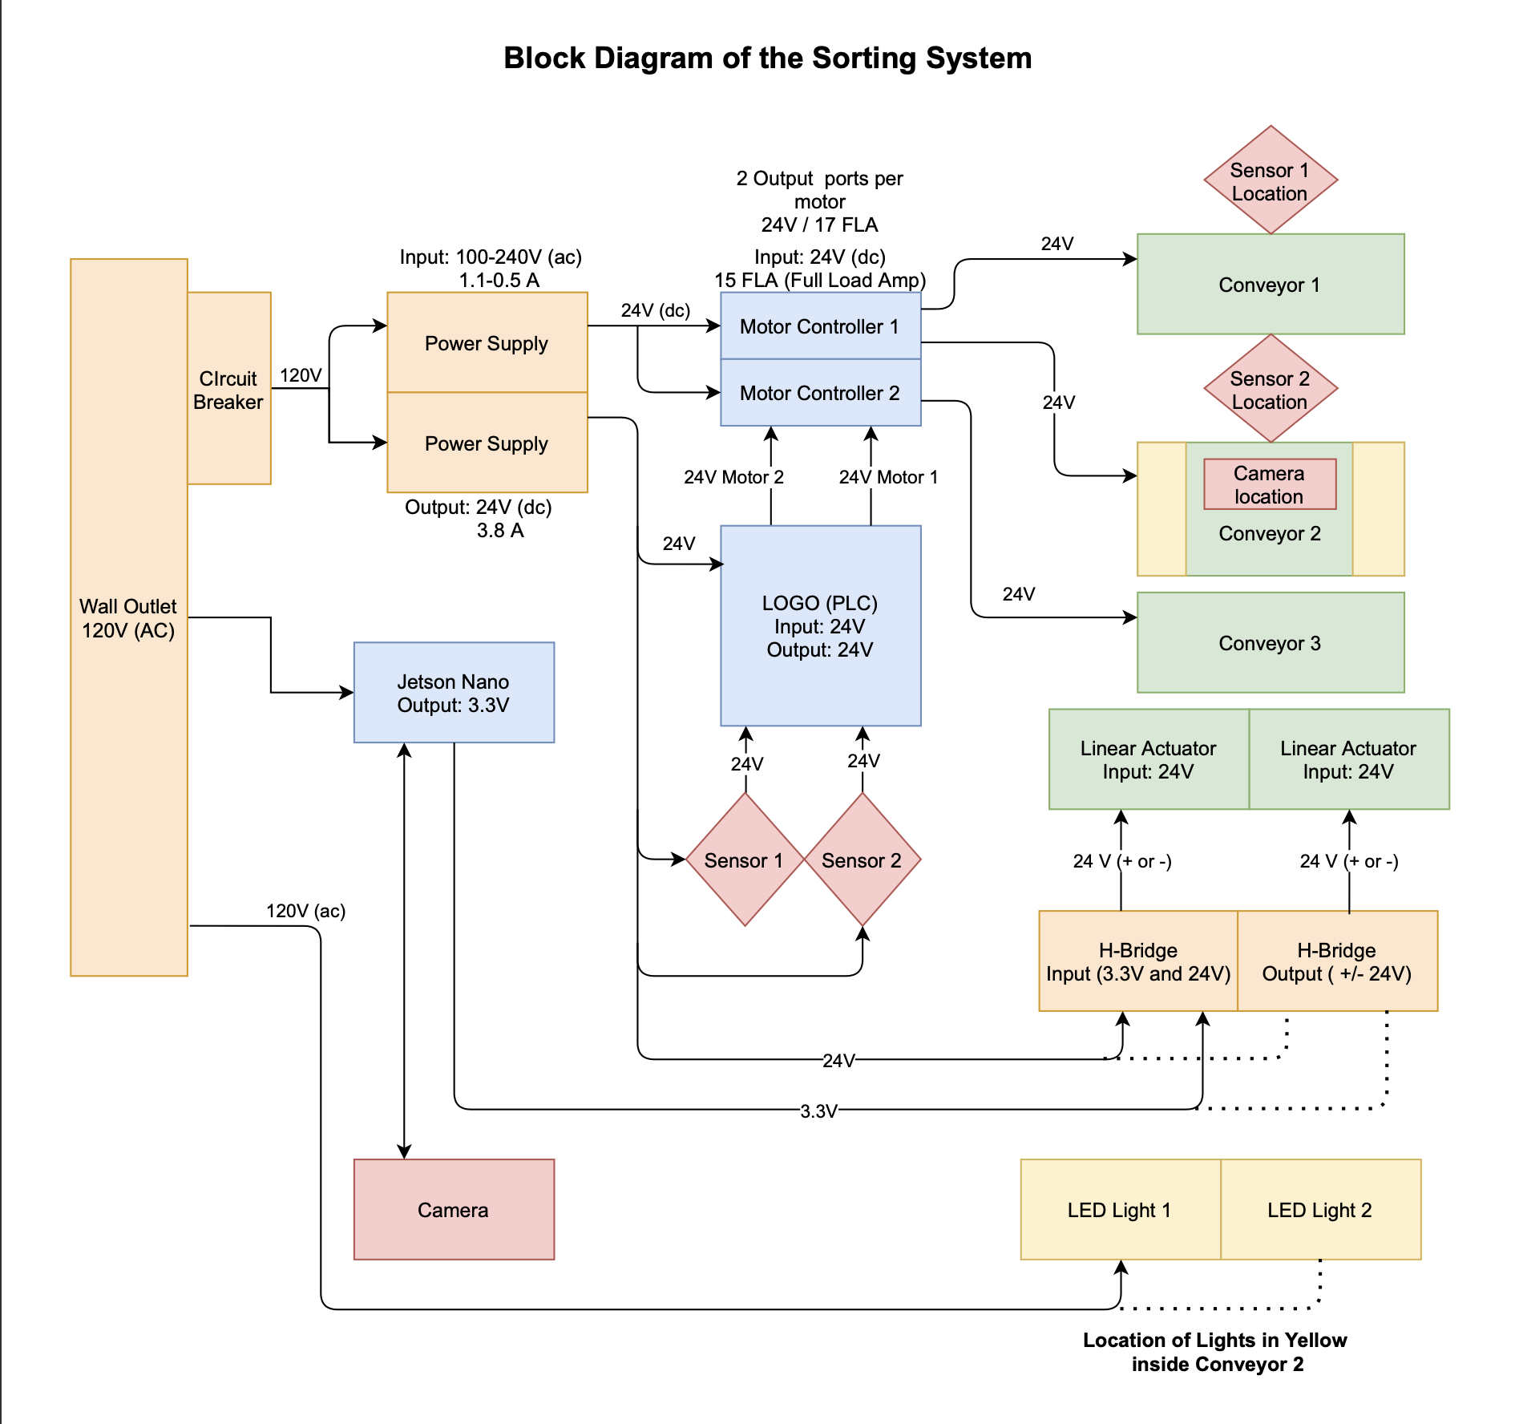
System
Block Diagram
Orange: Power Supply related devices
Blue: Control devices
Green: Output devices
Red: Input Devices

Slide 16
Mechanical

Slide 17
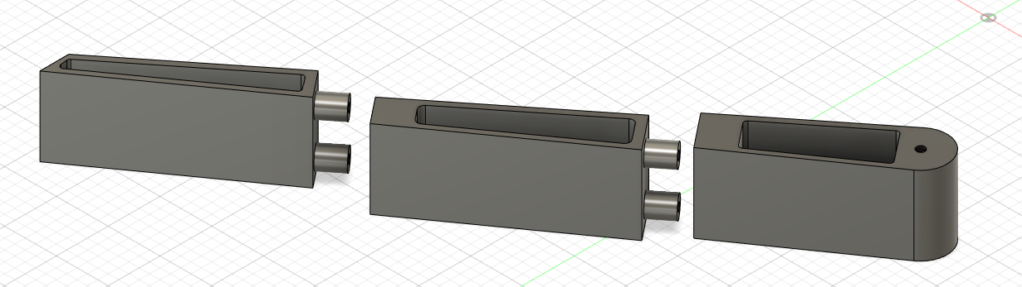
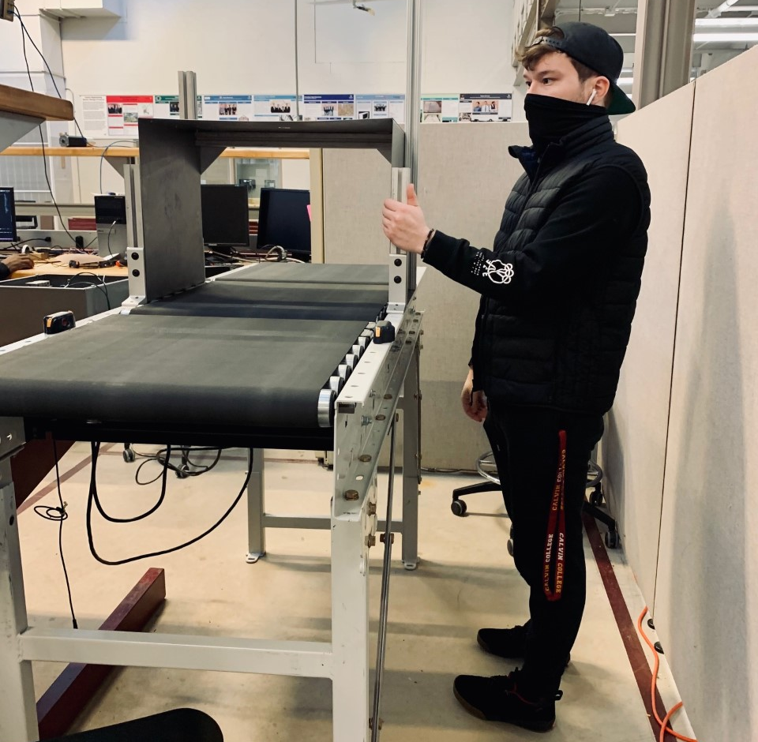
Progress
Conveyor Donated By Dematic.
Fabricated Camera Housing
3D Printing - Fusion 360
Linear Actuator selected and installed
New Bracket System designed completed and installed

Slide 18
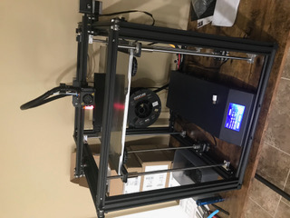
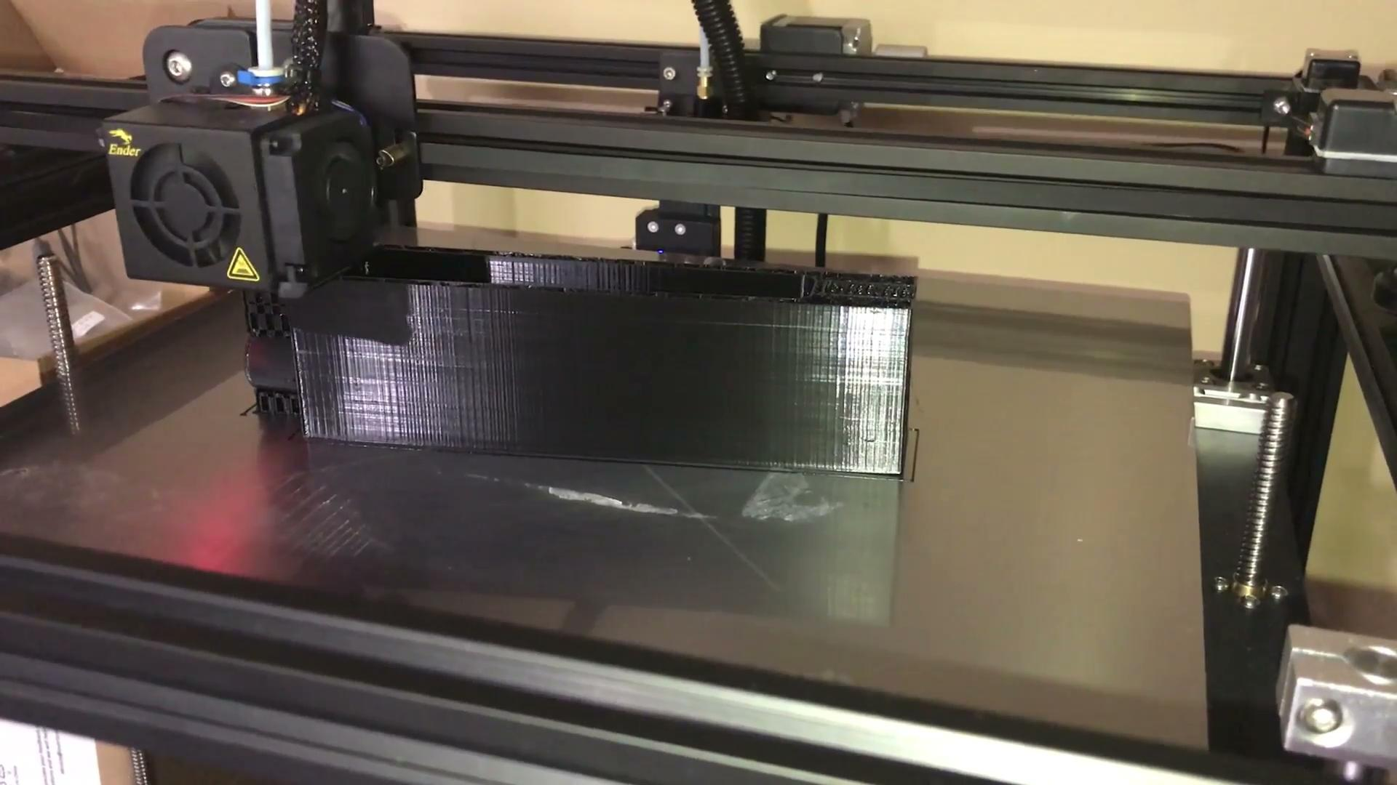
3D Printing
Benefit:
Able to create complex geometries
Easy to remodel/update parts
Easy to make Prototypes of parts
Drawbacks:
Long Printing Times
Plastic parts can warp during printing process
Printer: Ender 5 Pro

Slide 19
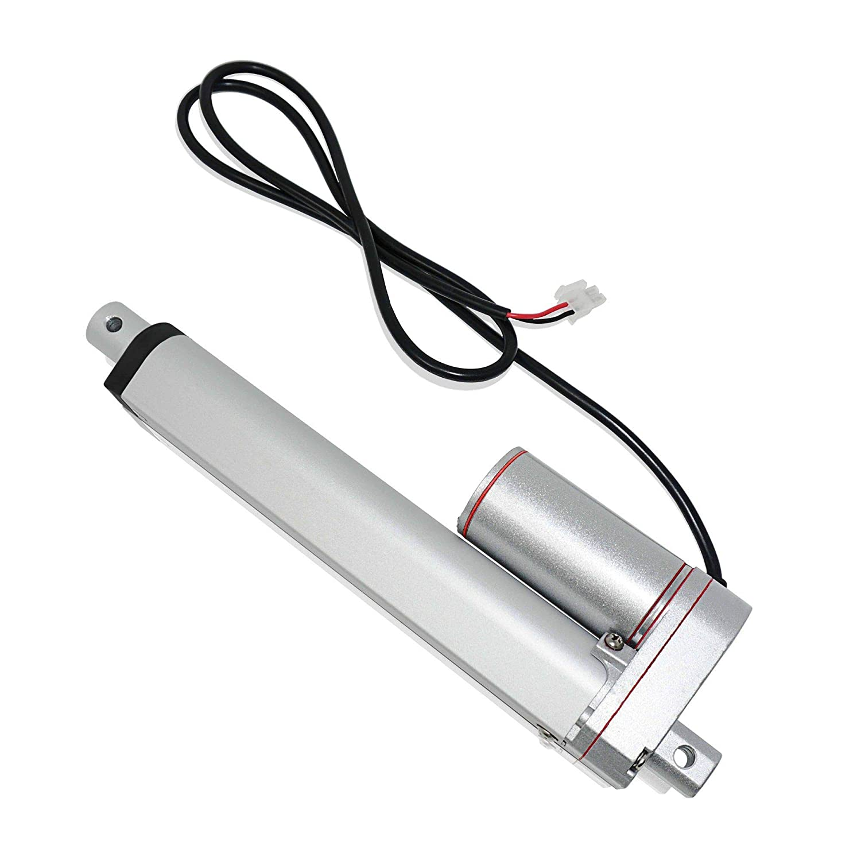
Linear Actuators
PROGRESSIVE AUTOMATIONS Mini Linear Electric Actuator
24V
2” Stroke Length
Moves up to 1.67 Pounds
0.28"/sec (no load)
Now able to convert linear motion into rotary motion
Why a linear actuator instead of an electric solenoid
Electric solenoid was weaker

Slide 20
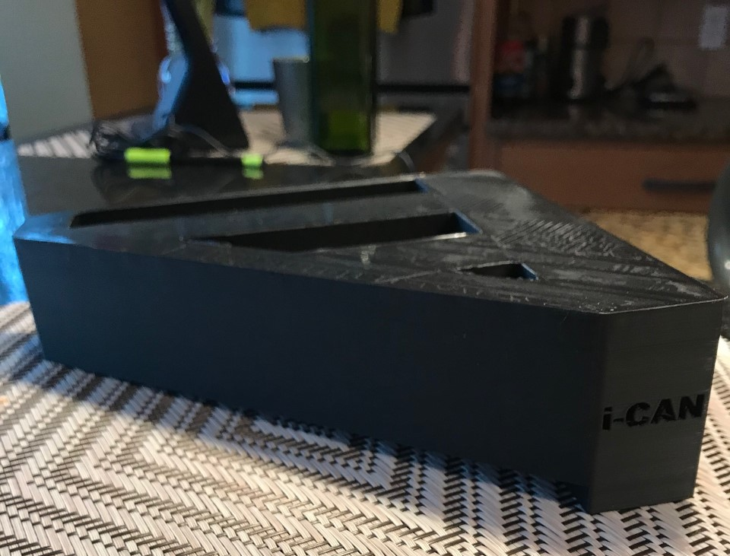
Future Goals
Have both pivot arms full printed and ready to be installed
Begin modeling funnels for the i-CAN
Design chutes

Slide 21
Electrical

Slide 22
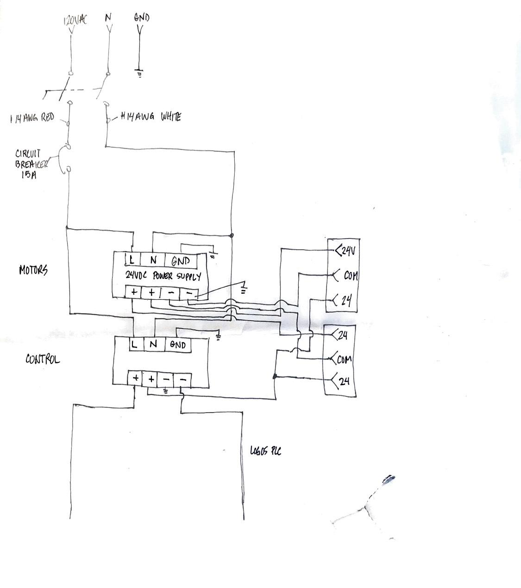
Progress
Designing phase mostly finished, may require some adjustments depending on other components
Currently working on wiring everything up and ensuring the system runs smoothly
Also working on getting all the different parts of the system to communicate with each other (PLC to Motor Controllers, Jetson Nano to Linear Actuator and etc)
Finally, need to rewire the system with better wire organization with most components inside the powerbox

Slide 23
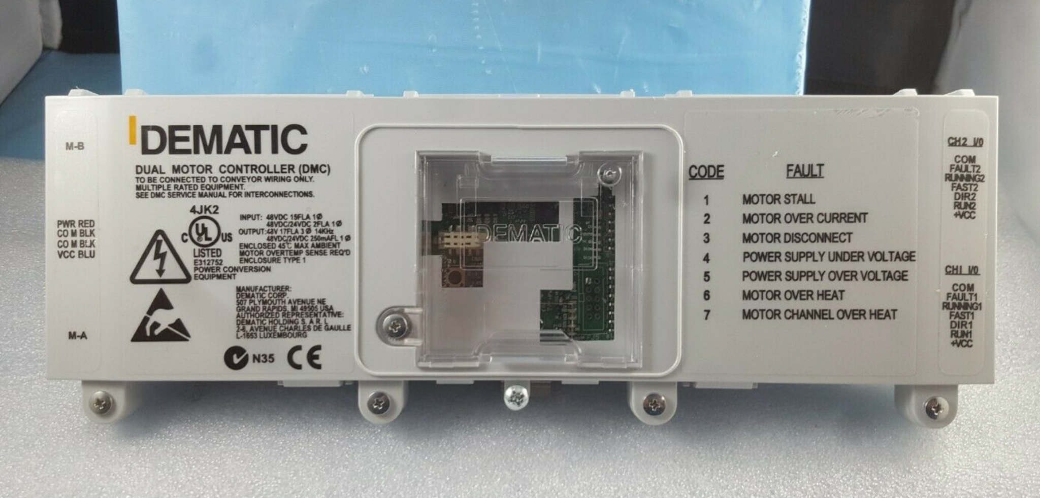
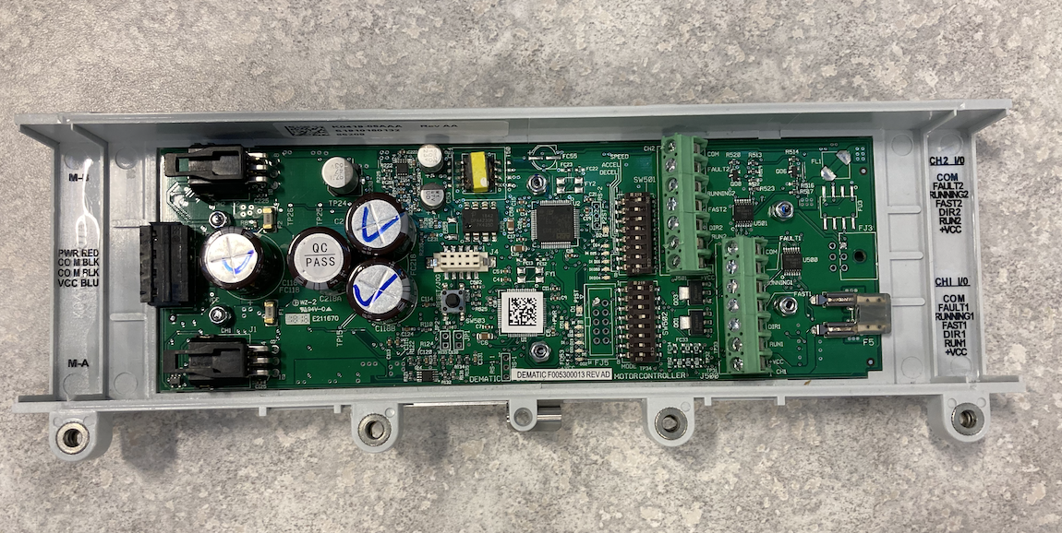
Motor Controller
Used to control the motors in the conveyor belt
Controlled by LOGO (PLC)

Slide 24
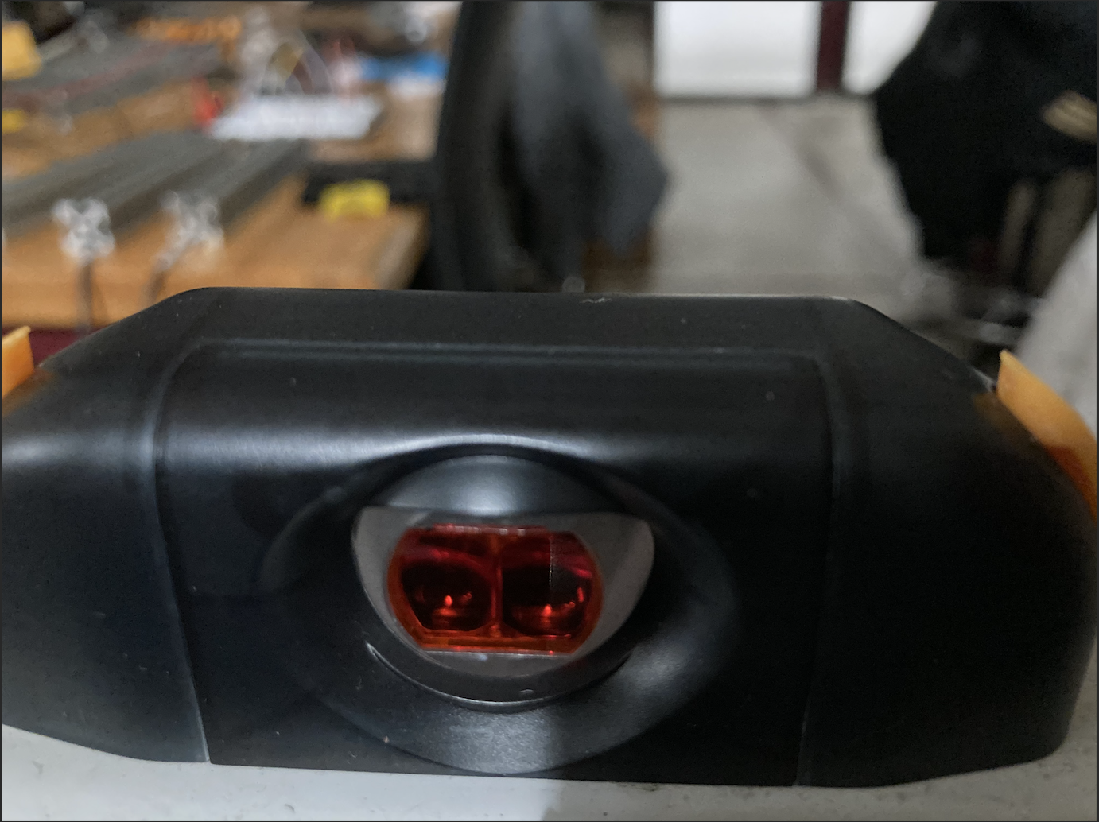
Sensors
Emits and receives an infrared light off of a reflector. Output is triggered when the light gets blocked.
Uses a PNP system and a 4 pin pigtail
Used by the LOGO as an input to communicate the location of the item

Slide 25
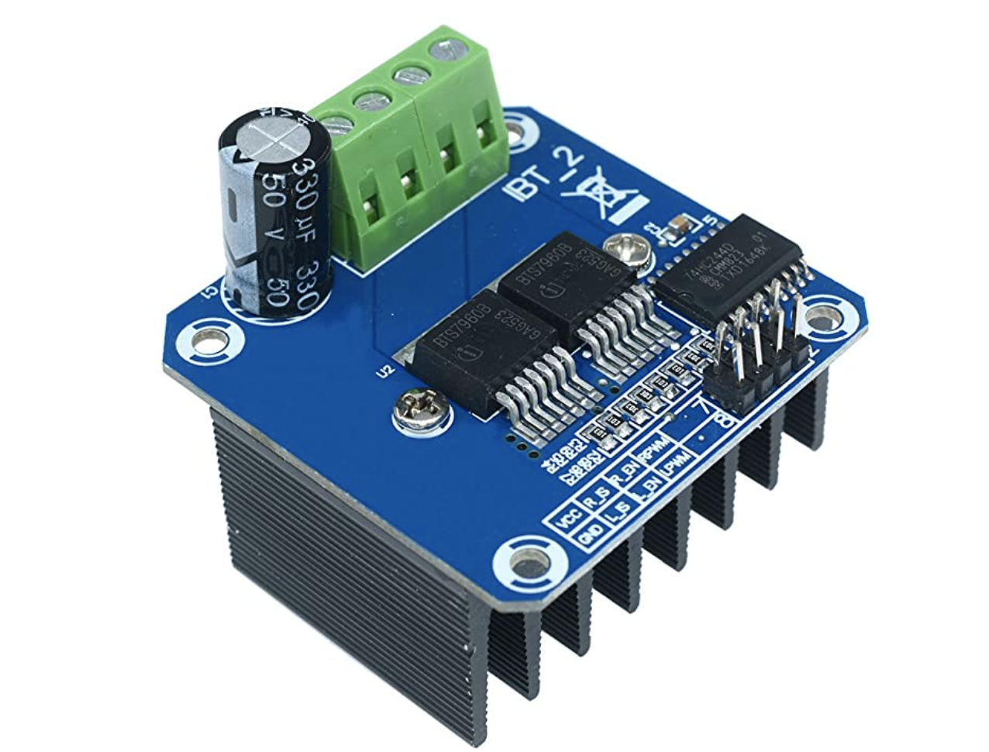
H-Bridge
Used to reverse the polarity of the input voltage in order to control the linear actuator.
Uses input pins that takes in 3.3V to control the device (ideal for the Jetson Nano)

Slide 26
Software

Slide 27
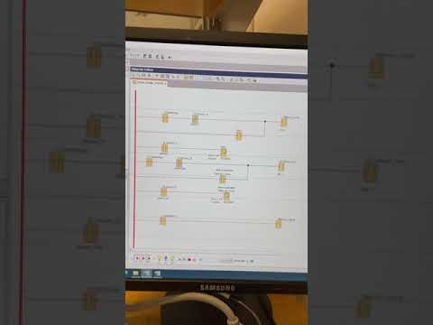
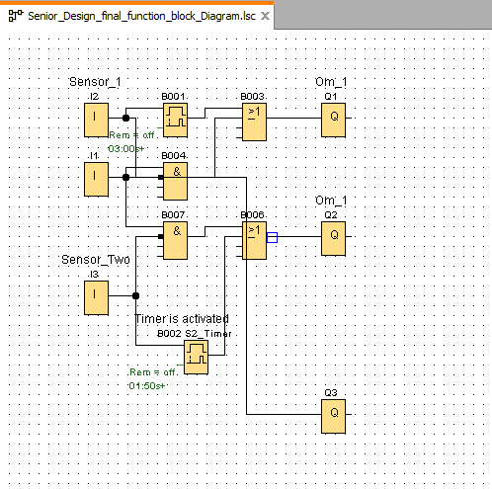
PLC program simulation

Slide 28
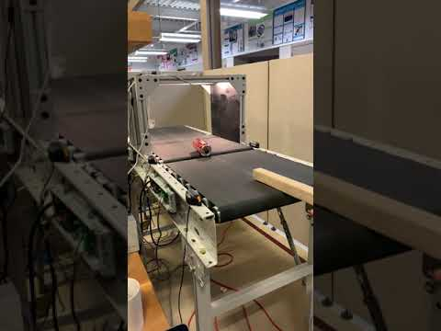
Conveyor test run

Slide 29
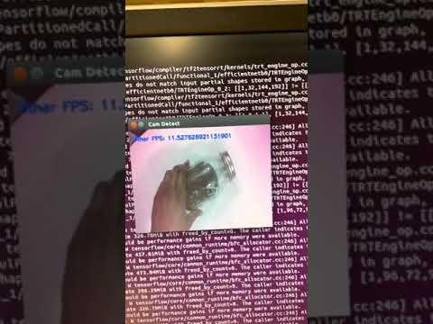
ML/CV
Changed initial model from ResNet50 Base to EfficientNet-Base
Model size was changed from 96MB to 16MB
Same mode of training (Transfer Learning)
Used TensorRT to speed up inference time

Slide 30
DataSet
TrashNet Training dataset mixed with IBM training dataset
2152 Images for training
430 images for validation.
Trained using Transfer Learning with an Efficient-Net Base
[Cardboard, Glass, Metal, Paper, Plastic]
Future work on DataSet (Adding more images from Calvin)

Slide 31
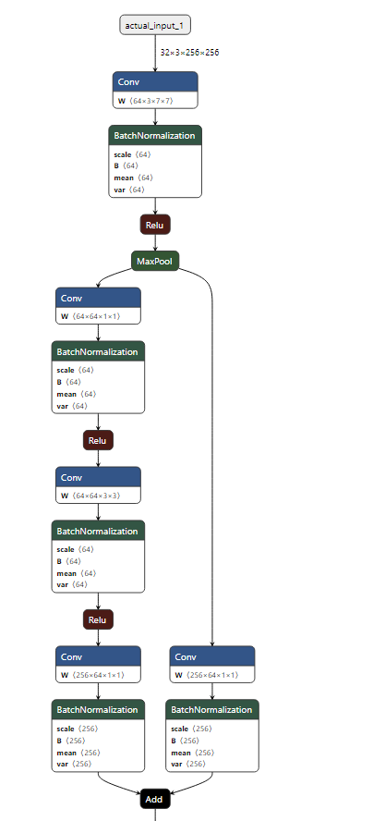
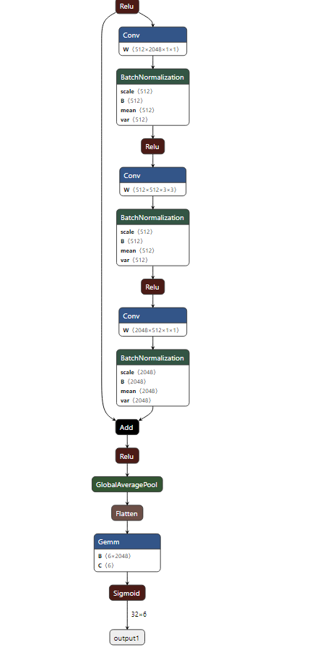
Model(visualized)

Slide 32
Challenges & Proposed resolution
Hardware limitations from Jetson Nano
“Other classification” was a dominant result during testing (Hypothesis: background issue) (Solution: white background)
Siemens hardware accessibility [Logo Soft Comfort] [new drivers][software from electromatic]

Slide 33
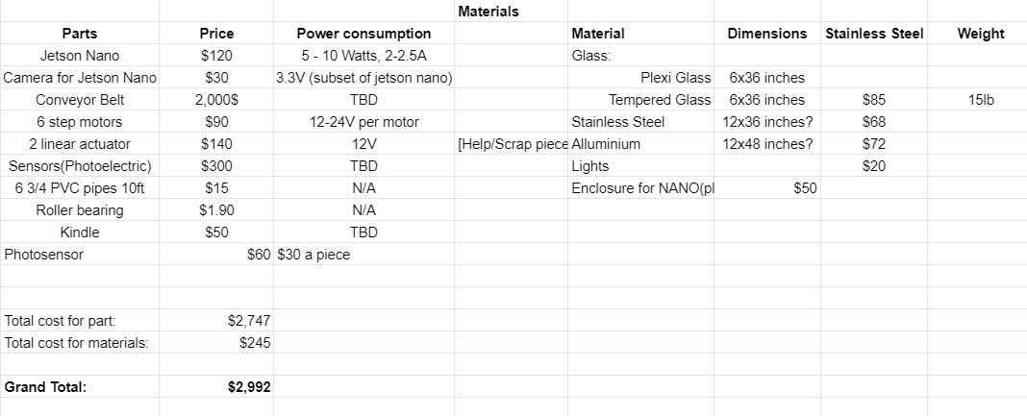
Business model/ Finances ( $4K)
Finances[including] $4K

Slide 34
Questions?

